Slide 1


Slide 2
Outline
What is JS?
Why Study JS?
History of JS
JS Versions

Slide 3
Learning Materials
MDN https://developer.mozilla.org/bm/docs/Web/JavaScript
W3Schools JS Tutorial https://www.w3schools.com/js/default.asp
W3Schools Practice https://www.w3schools.com/js/exercise_js.asp
You Don't Know JS: Up & Going https://github.com/getify/You-Dont-Know-JS/tree/master/up%20%26%20going
You Don't Know JS: Scope & Closures https://github.com/getify/You-Dont-Know-JS/blob/master/scope%20&%20closures/README.md#you-dont-know-js-scope--closures
You Don't Know JS: this & Object Prototypes https://github.com/getify/You-Dont-Know-JS/blob/master/this%20&%20object%20prototypes/README.md#you-dont-know-js-this--object-prototypes
You Don't Know JS: Types & Grammar https://github.com/getify/You-Dont-Know-JS/blob/master/types%20&%20grammar/README.md#you-dont-know-js-types--grammar
You Don't Know JS: Async & Performance https://github.com/getify/You-Dont-Know-JS/blob/master/async%20&%20performance/README.md#you-dont-know-js-async--performance
You Don't Know JS: ES6 & Beyond https://github.com/getify/You-Dont-Know-JS/blob/master/es6%20&%20beyond/README.md#you-dont-know-js-es6--beyond
Vue.js https://vuejs.org/

Slide 4


About me
Antony Orenge
Masters in Software Engineering
University of Tartu, Estonia.
Senior Software Engineer at BRCK
https://github.com/antorenge

Slide 5
What is JS?

Slide 6
JavaScript (JS) is a lightweight, JIT compiled programming language with first-class functions.
ECMAScript is the official name of the language. ECMAScript is often abbreviated to ES.
JS mostly runs on the client side of the web, which can be used to design/program how web pages behave on the occurrence of an event.
Notes:
First class functions means that the language supports passing them as arguments to other functions, returning them as values and assigning them to variables or storing them in data structures.
V8 is Google’s open source high-performance JavaScript and WebAssembly engine, written in C++. It is used in Chrome and in Node.js, among others. It implements ECMAScript and WebAssembly, and runs on Windows 7 or later, macOS 10.12+, and Linux systems that use x64, IA-32, ARM, or MIPS processors. V8 can run standalone, or can be embedded into any C++ application.

Slide 7

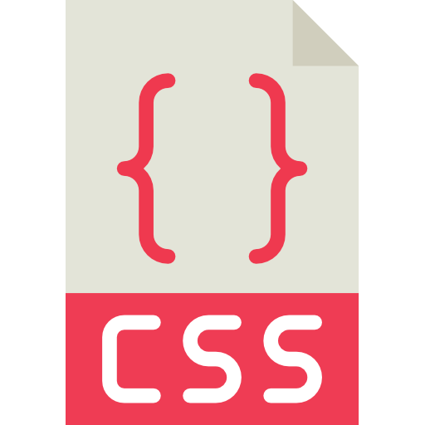


HTML defines the structure of a web page
CSS defines the presentation of the web page
JS defines the behavior of the web page

Slide 8
JS is a prototype-based, multi-paradigm, dynamic scripting language, supporting object-oriented, imperative, and declarative (e.g. functional programming) styles
JavaScript is a single-threaded programming language, which means it has a single Call Stack. Therefore it can do one thing at a time.
Apart from its use in web pages, JS can also be used in non-browser environments such as desktops and servers using Node.js, and databases (Mongo, CouchDB).

Slide 9


JS is NOT Java
Though they are registered trademarks of Oracle, the have very different syntax, semantics and uses.
!==

Slide 10
Why Study JS?

Slide 11
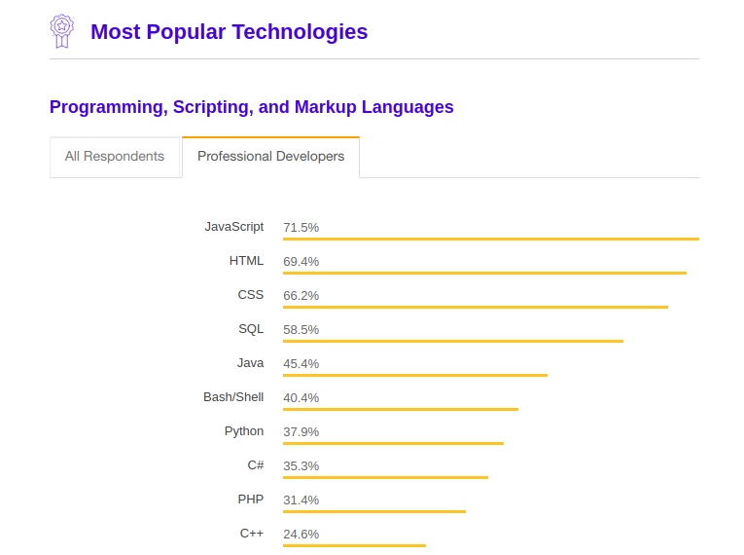
According to the Stack Overflow’s 2018 Developer Survey, 71.5% of professional developers rank JavaScript as the most popular programming language. This is quite an increase from 2015 when only 54.4% of developers ranked JavaScript as the most popular technology. (https://insights.stackoverflow.com/survey/2018/#technology)

Slide 12
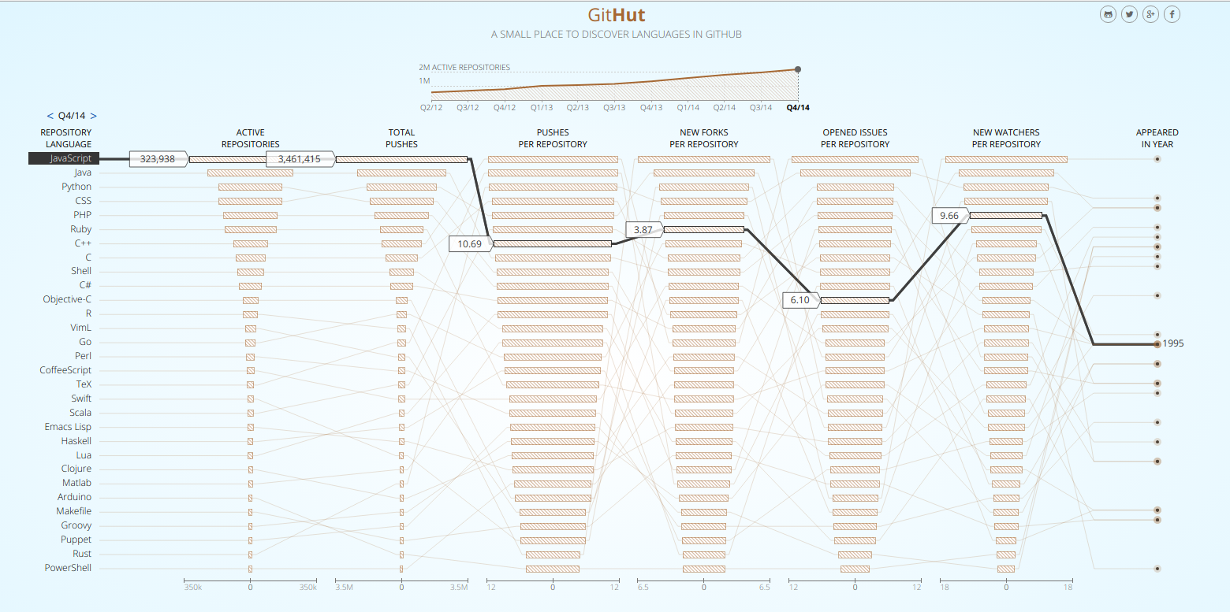
Popularity
https://githut.info/ (Feb, 2019)
Notes:
As shown in the GitHut stats, JavaScript is at the top in terms of Active Repositories and Total Pushes in GitHub. It doesn’t lag behind much in the other categories either.

Slide 13




Use cases of JS
Frontend development using frameworks such as React, Angular and Vue
Backend development using NodeJS, CouchDB and Mongo

Slide 14
History of JS

Slide 15
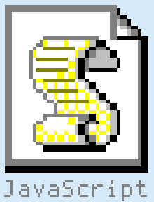

=>
Stone Age
2019

Slide 16
JS was invented by Brendan Eich in 1995, while working at Netscape.
Netscape 2 was the first browser to run JS
In 1997, ECMA International adopted JS and developed ECMA standard and ECMAScript (ES).
ECMA-262 is the official name of the standard. ECMAScript is the official name of the language.
After Netscape the Mozilla foundation continued to develop JS for the Firefox browser.
Notes:
Ecma International (formally European Computer Manufacturers Association) is a non-profit organization that develops standards in computer hardware, communications, and programming languages.

Slide 17
JS Versions

Slide 18
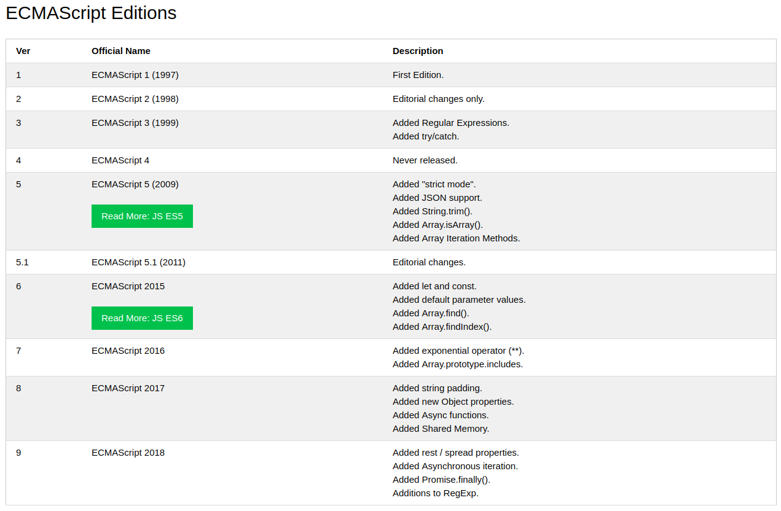
https://www.w3schools.com/js/js_versions.asp
Notes:
Internet Explorer 9 does not support ECMAScript 5 "use strict".
Internet Explorer does not support ECMAScript 2015.

Slide 19
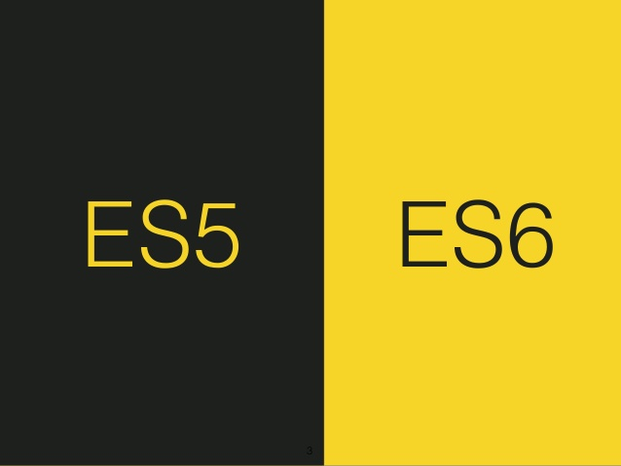

Slide 20
ES5 vs ES6
ECMAScript 5 Features
The "use strict" Directive
String.trim()
Array.isArray()
Array.forEach()
Array.map()
Array.filter()
Array.reduce()
Array.reduceRight()
Array.every()
Array.some()
Array.indexOf()
Array.lastIndexOf()
JSON.parse()
JSON.stringify()
Date.now()
Property Getters and Setters
New Object Property Methods
ECMAScript 6 Features
ECMAScript 6 is also known as ES6 and ECMAScript 2015. Some people calls it JavaScript 6.
JavaScript let
JavaScript const
Exponentiation (**)
Default parameter values
Array.find()
Array.findIndex()

Slide 21
// ES5
var x = function(x, y) {
return x * y;
}
// ES6
const x = (x, y) => x * y;

Slide 22
Next class
Introduction to Programming
Statements
Expressions
Output
Input
Operators
Values & Types
Course material: https://github.com/getify/You-Dont-Know-JS/blob/master/up%20%26%20going/ch1.md

